Slide 1
Developing with the SharePoint Framework: Web Parts
Testing the Web Part in the Local & Hosted Workbench

Slide 2

Exploring a SharePoint Framework Project
Local Workbench
Hosted Workbench
Different modes of the gulp serve task

Slide 3
Local Workbench vs. SharePoint Workbench
Local
Runs on https://localhost
Has no SharePoint Context
Developers can leverage uses mock data
SharePoint (Hosted)
Runs on a real SharePoint Site
https://<your-sharepoint-site>/_layouts/workbench.aspx
Has SharePoint Context
Uses SharePoint data

Slide 4
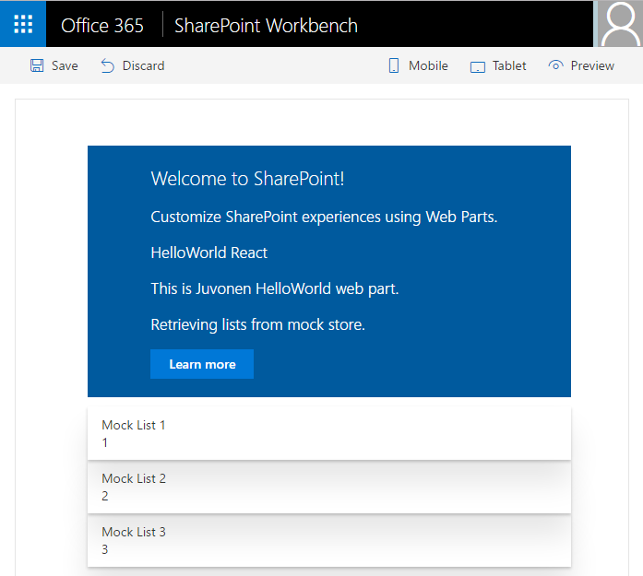
SharePoint Workbench
Local development time experience
Test your changes immediately even in offline mode

Slide 5
Debugging
Build and run on local server and automatically launch local SharePoint Workbench
Build and run solution on local server
> gulp serve
> gulp serve --nobrowser

Slide 6



Mapping Files Making Debugging Easier
SPFx web parts are authored in TypeScript
The build process transpiles the TypeScript into JavaScript, then bundles it all into a single file
As a result, it can be hard to debug the resulting JavaScript bundle
Source code mapping files make it possible to debug the original unbundled TypeScript code

Slide 7
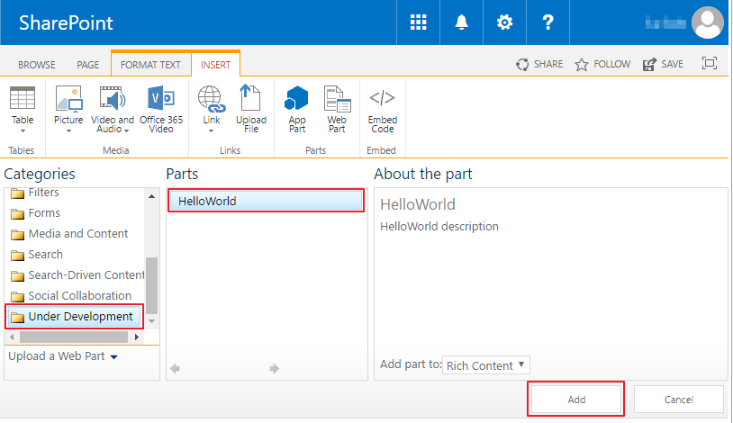
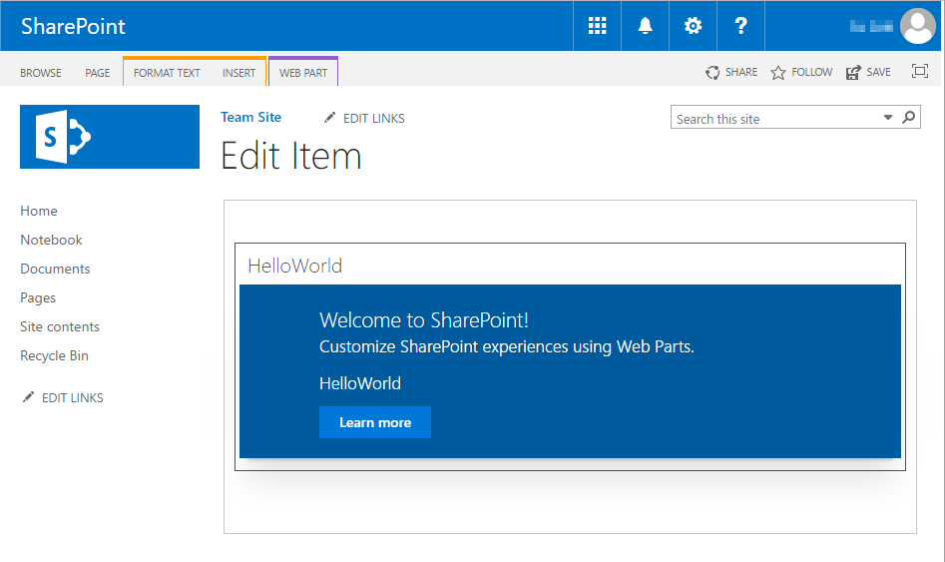
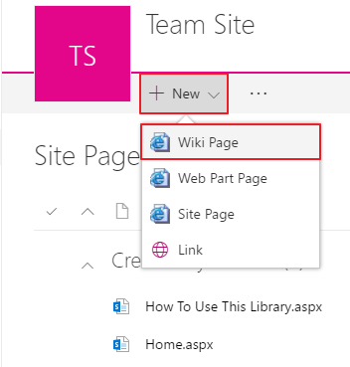
Classic Page

Slide 8
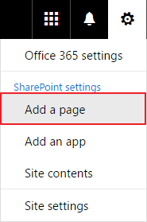
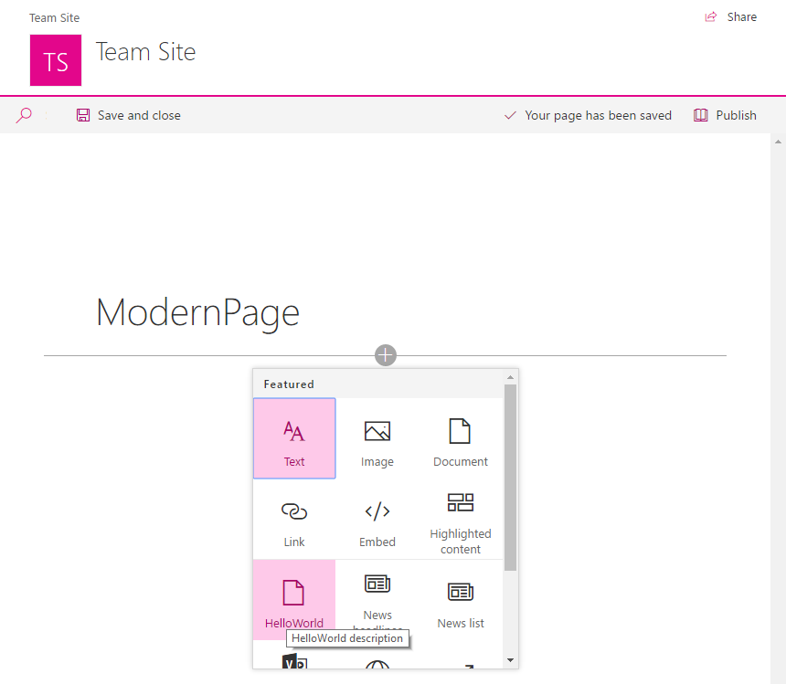
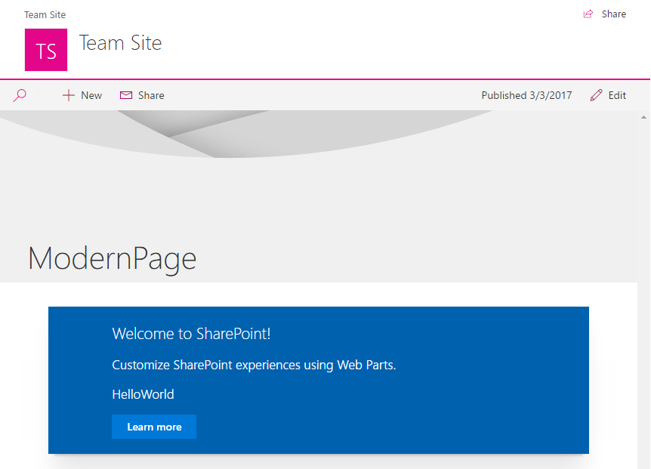
Modern Page

Slide 9
Demo Testing the Web Part in the Local & Hosted Workbench

Slide 10

Summary
Local Workbench
Hosted Workbench
Different modes of the gulp serve task

Slide 11
Reading further
Debugging SharePoint Framework solutions in Visual Studio Code
https://docs.microsoft.com/sharepoint/dev/spfx/debug-in-vscode
Debug SharePoint Framework solutions on modern SharePoint pages
https://docs.microsoft.com/sharepoint/dev/spfx/debug-modern-pages
Use the developer dashboard
https://docs.microsoft.com/sharepoint/dev/spfx/use-developer-dashboard

Slide 12
Thank you.

